Slide 1
Introducing Control in an Open Online Course
Richard Mitchell
Computer Science
University of Reading

Slide 2
Abstract
Begin Robotics - successful open online course – on FutureLearn - around 30,000 participants over four runs.
Aimed at introducing robotics, cybernetics, artificial intelligence, control and haptics to Key Stage 3 pupils, it has been taken by other groups from around the world.
Paper discusses course, introduction of Control, its use at undergraduate level, and positive reaction.

Slide 3
Background
Robotics has been successfully used for outreach / recruitment – talks + demonstrations / competitions
Begin Programming – first Reading MOOC* – now had around 200,000 enrolments –attracted many students
So we developed Begin Robotics
Follows relevant MOOC pedagogy (see paper)
Aims – introduce robotics – with hands on experience
Level – Key Stage 3 / 4, adaptable to undergraduate
Discusses some research concepts
Unlike other courses, does not focus on one robot
*Massive Open Online Course

Slide 4
Course Structure and Features
Four week course
Week 1: Intro course, feedback, robots, exercises
Week 2: Sensors, actuators, brain and power
Week 3: Feedback for control and interaction
Week 4: Feedback for learning
Comprises, short videos, articles to read/discuss, exercises, MCQs
Features Interactive web pages
illustrating videos/articles and for exercises
Each week has ‘Meet the reading robots’ feature

Slide 5
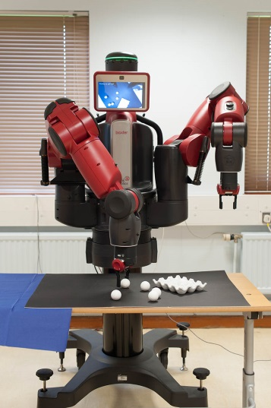
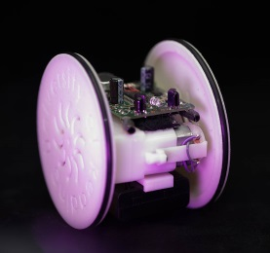
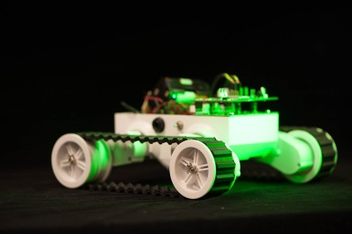
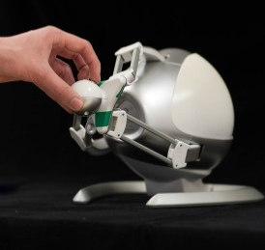
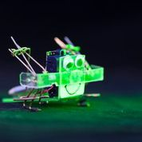
Robots at Reading used in Course
Baxter
ERIC
(early version)
Rover
Used in Part 2 project
Haptic device
Scampi
Robot - ant wars

Slide 6
Interactive Web Pages
Outreach activities – important students do something
For online course, web pages seem way forward
Javascript pages utilised – no software to download
Embedded within FutureLearn platform, but available at
  https://www.reading.ac.uk/UnivRead/vr/OpenOnlineCourses/Files/Simulation2/BeginRoboticsSimulationindex2.pdf
Two uses
  Exercises for students to do
  Illustration of key features

Slide 7
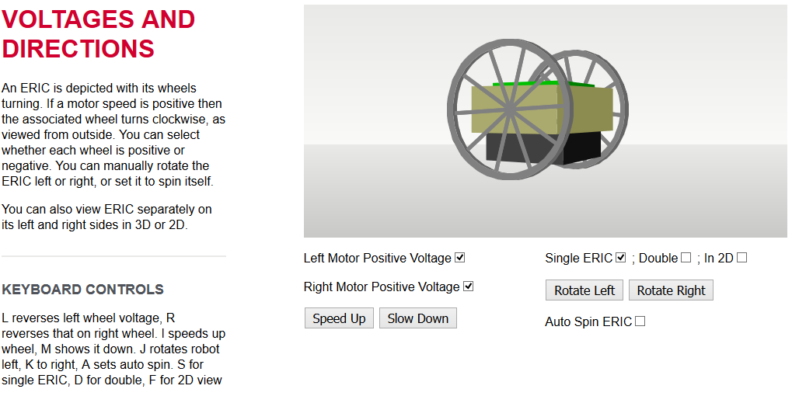
Examples
http://www.reading.ac.uk/UnivRead/vr/OpenOnlineCourses/Files/Simulation2/demoEric.html

Slide 8
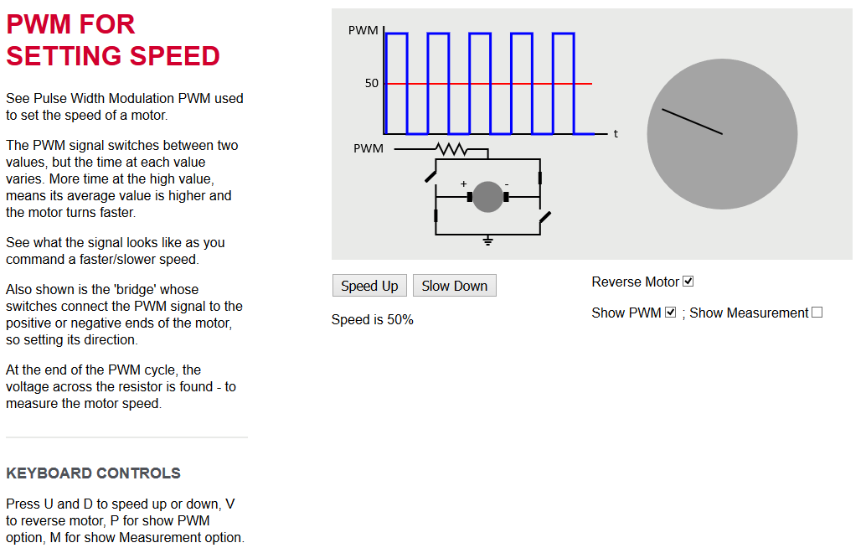
Explaining PWM
http://www.reading.ac.uk/UnivRead/vr/OpenOnlineCourses/Files/Simulation2/demoPWM.html

Slide 9
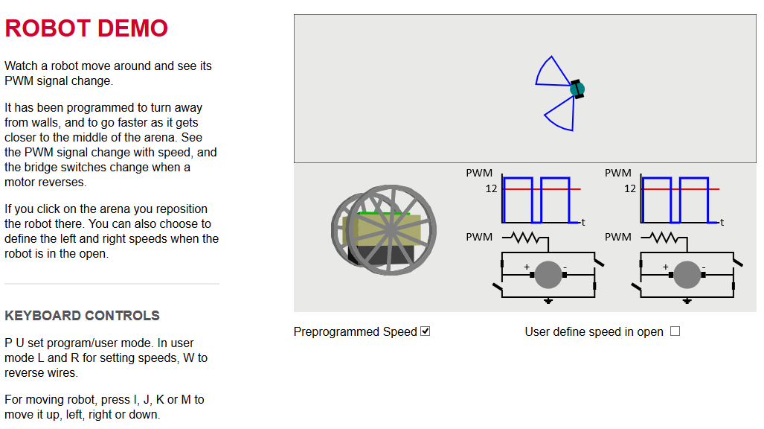
Page developed after User Comment
http://www.reading.ac.uk/UnivRead/vr/OpenOnlineCourses/Files/Simulation2/robotPWM.html

Slide 10
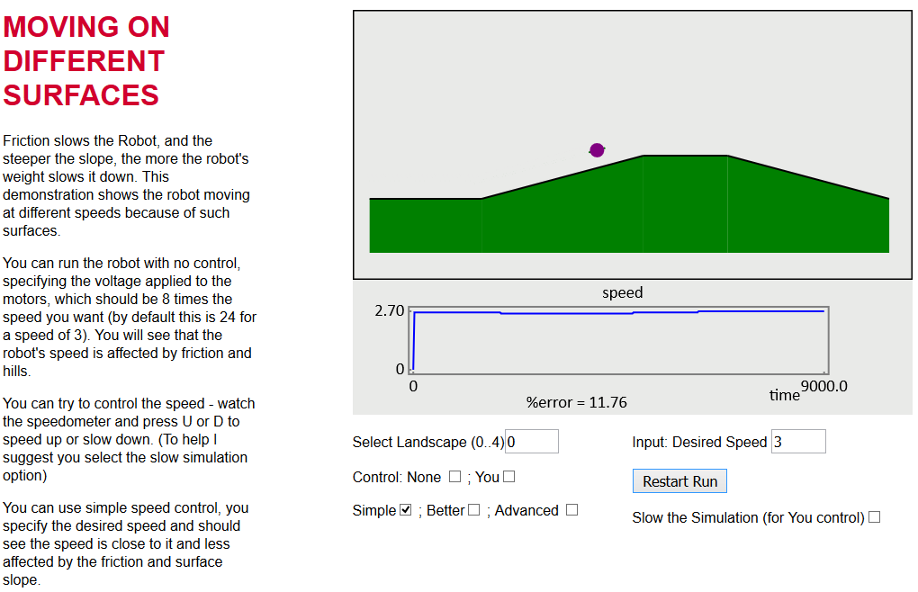
Illustrating the Need for Control
http://www.reading.ac.uk/UnivRead/vr/OpenOnlineCourses/Files/Simulation2/demoSpeedControl.html

Slide 11
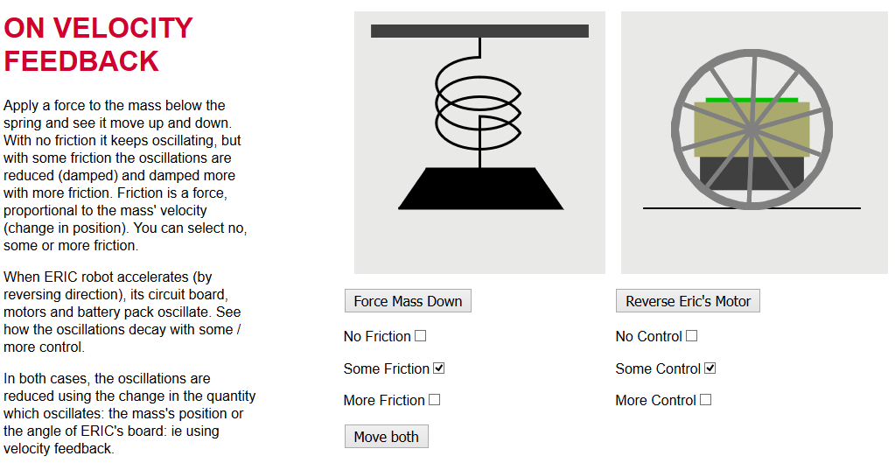
Velocity Feedback – ERIC’s ‘Rock’
http://www.reading.ac.uk/UnivRead/vr/OpenOnlineCourses/Files/Simulation2/demoMassSpring.html

Slide 12
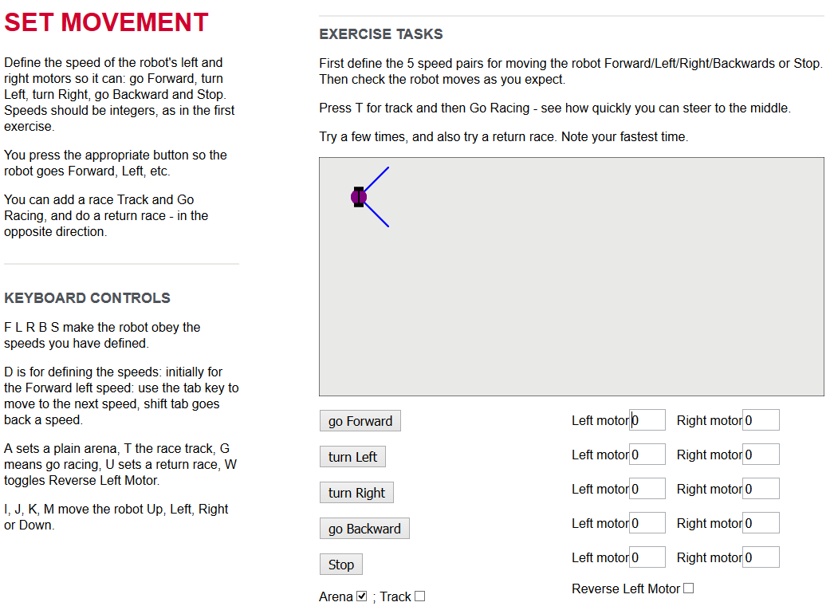
Exercise Pages
First Exp’t
L and R motor speeds
Second ..
Includes Navigate Track

Slide 13
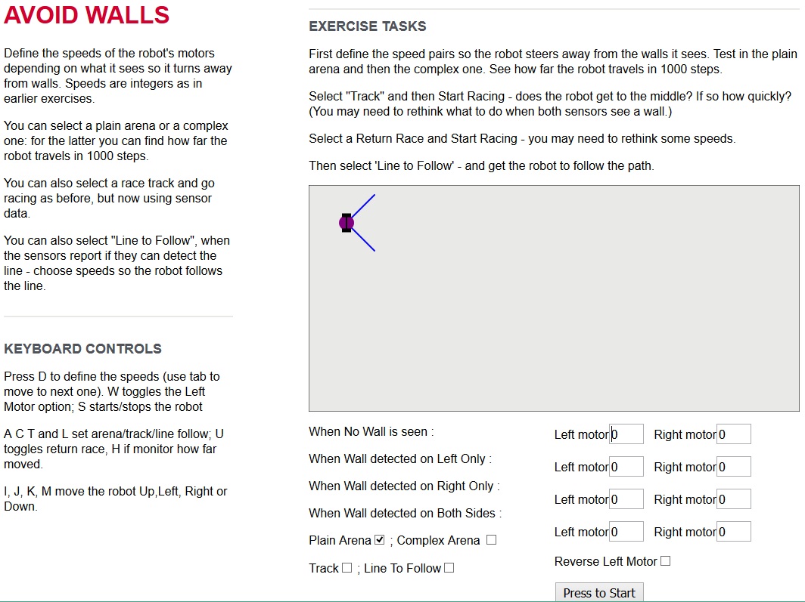
Week 2
Using sensors move avoiding walls / follow line
Next
steer towards lights

Slide 14
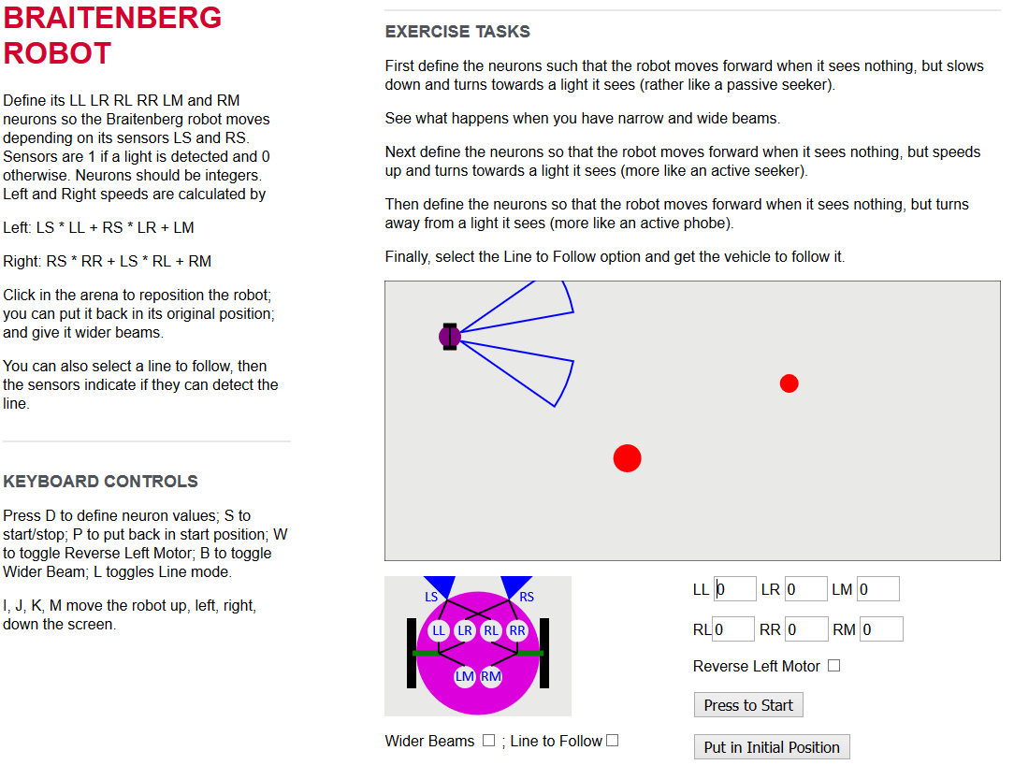
Week 4 – This and Nav. Maze

Slide 15
Use of Material for Undergraduates
First year course on cybernetics
Web pages used to illustrate need for control
Damping of second order systems
Formed Part 1 Lab experiments
First year course on robotics
Third run timed to coincide with colleague’s lectures
Students invited to do MOOC also
Fifth run will coincide when I teach robotics next year
Plan to link assessments with those on the MOOC
Will in effect ‘flip’ the lectures

Slide 16
Very Positive Reaction
Teachers found simulations very useful and wanted to use at schools … hence pages available .. appreciated.
“Thank you for a truly excellent course that exceeded my expectations. By removing all the barriers to education that are still present in many online courses you allowed one to relax and concentrate on the learning. It made for a much more pleasant learning environment that encouraged exploration and experimentation. The use of simulations put this course head and shoulders above the competition.”

Slide 17
On Control
“Was a good idea to introduce a feedback control to reduce the oscillations of ERIC, this issue had already detected previously, simulations helped me to better visualize and control reactionary already applied.”
“Great explanation, I think there are many similarities between the mass-spring model and the system shown, it is a clear example of a mathematical model which can represent a system.”

Slide 18
From FutureLearn
“The simulations Dr. Mitchell produced for the course brought the topic to life for learners and enabled them to understand & experience robotic principles in a far more engaging way than would otherwise be possible. Encouraging learners to experiment and discuss with others is core to FutureLearn's approach to learning, and it was great to see a course adopt this so thoroughly and to such success. Most importantly, it let students have fun learning. This enjoyment was evident in hundreds of comments across the different exercises”.

Slide 19
Conclusion
Course has successfully introduced robotics and control to a large audience
Interactive Web Pages have been particularly popular
Course has attracted students to Reading
Some of the pages and exercise have been used for undergraduate laboratory experiments
One run coincided with Part 1 Robots course
Next run will coincide with first time I teach robotics
So analysis planned on impact of this.

