Slide 1
A Cybernetic Approach to Introducing Robotics
Richard Mitchell
Professor of Cybernetics
University of Reading

Slide 2
Introduction
I came to Reading as a student in cybernetics in 1977 …
I have lectured in Cybernetics since 1983
My interests : robots, control engineering, artificial intelligence, virtual reality, GAIA theory, education
I am lead educator on the Begin Robotics Massive Open Online Course which runs on FutureLearn
This talk gives an overview of the course, the cybernetic approach taken, including its interactive web pages.

Slide 3
On Cybernetics
Key to Cybernetics is feedback
For control
For learning
For interaction
Learning should be active
So produce interactive web pages
Concepts applicable to different systems
Eg Robotics - opportunity to enthuse and illustrate
Hence Begin Robotics – FutureLearn MOOC

Slide 4
Begin Robotics
Four Weeks
Introduction; History; Applications; Try Web pages
Anatomy of Robots – Sensors, Actuators, Brain
Control and Interaction (haptic devices)
Learning and artificial life
Open to all, also used to introduce Robots in Year 1
Web pages freely available
https://www.reading.ac.uk/UnivRead/vr/OpenOnlineCourses/Files/Simulation2/BeginRoboticsSimulationindex2.pdf
Used to illustrate concepts and for active learning

Slide 5
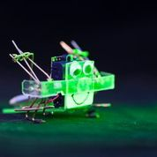
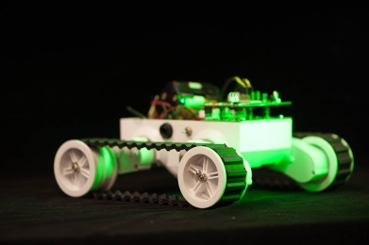
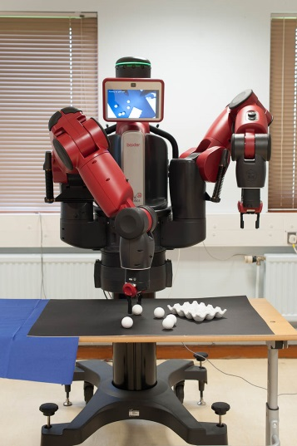
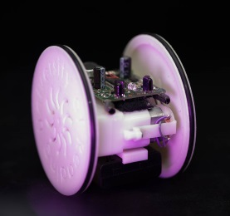
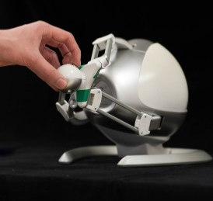
Robots Featured

Slide 6
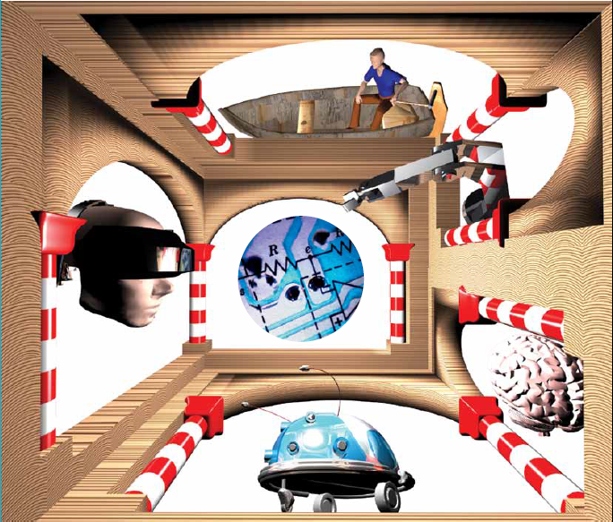
Cybernetics – A Different Perspective
Kybernetes (Steersman)
Robots
Neural Nets
Learning Robot
VR
Sensors
all use feedback

Slide 7
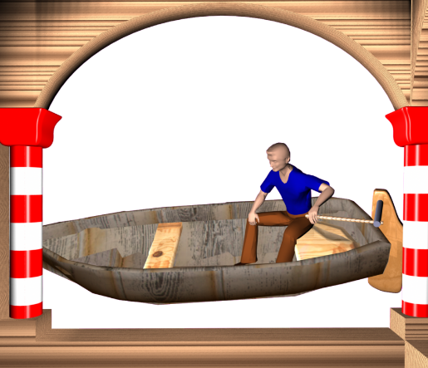
Feedback for Control
No feedback
Winds/Tides
Course
Guess
Boat
Winds/Tides
Course
Boat
Left /
-
+
Right
Steersman

Slide 8
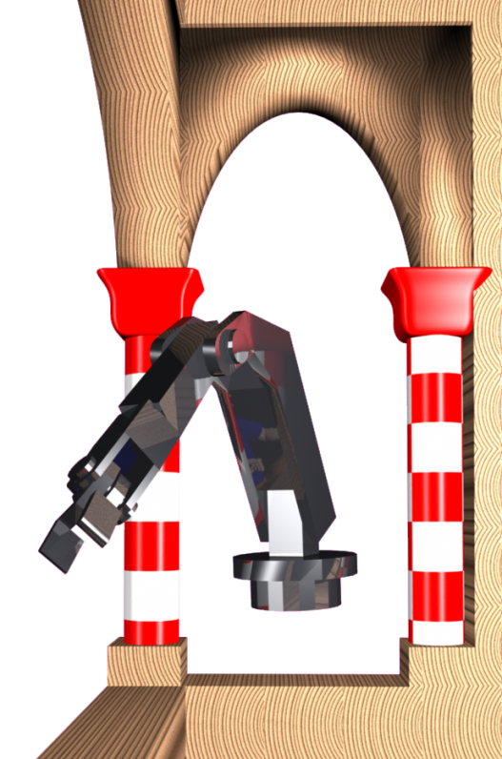
For manipulator robots
Positioning Robot Gripper
Obstacles
Position
Turn
Robot Arm
Clock
/ Anti
-
+
Joint Motors

Slide 9
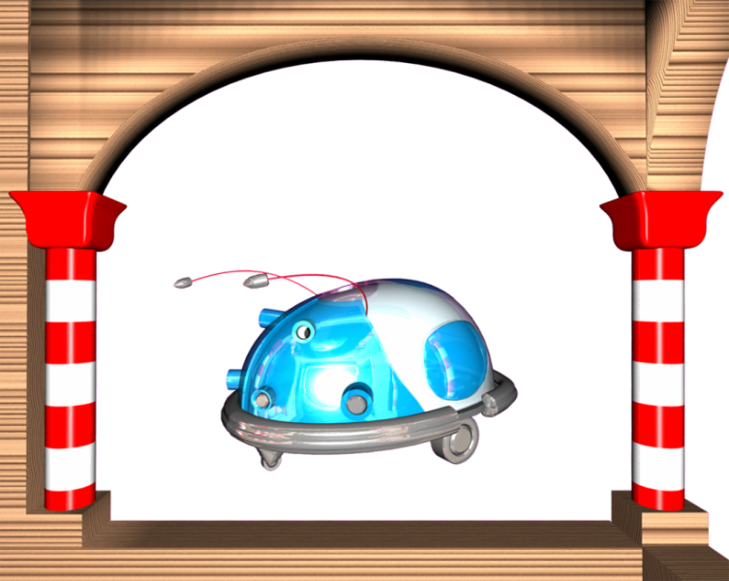
And Mobile Robots
Speed control
Hills, Surface
Speed
Robot
Slow /
-
+
Speed
Measure

Slide 10
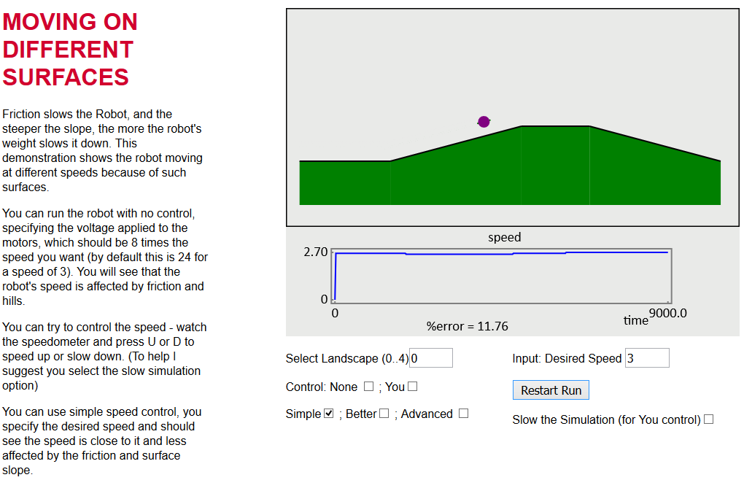
Illustrating Need for Control
http://www.reading.ac.uk/UnivRead/vr/OpenOnlineCourses/Files/Simulation2/demoSpeedControl.html

Slide 11
Different Speed vs Time
3.40
No control
0
% error = 39.23
14425
2.77
Prop Control
% error = 12.63
0
9075.0
3.43
User Control
(speedo)
% error = 4.97
0
16150
3.00
P+I
0
% error = 0.00
9025.0
Notes:
Explain user does control = control + ‘error’ not control = const * error

Slide 12
Also : Temperature Control
Of Rooms
Sun, PCs, People
Temperature
Room
Heat /
Cool
-
+
Air Con
Sun, Illness, etc
Temperature
Body
Sweat /
-
+
Shiver
Action
Of Humans

Slide 13
Also Of Earth - Gaia Theory
Lovelock suggest life helps control temperature
Sufficiently constant for life for 3.6 billion years
Even though suns output up by 25%
Biologists sceptical : hence Daisyworld
Sun
Black / white daisies
Grow best ~22^{O}C
Warm/Cool local area
If too cool, more black
Temp
Planet
Black /
White
Daisies
Like robots, example of artificial life

Slide 14
Demo Daisyworld

Slide 15
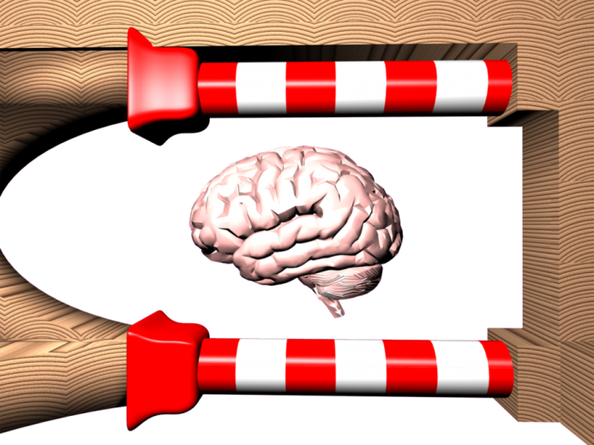
Learning – is also feedback
A steersman has to learn
Complex systems need adaptive control
Learning is a feedback process:
‘You learn by your mistakes’
Trial and Error
Well done?
Do Task
Better
Way
Refiner
Notes:
A steersman has to learn how to control a boat; Complex systems need a controller that adapts (learns)
Learning is a feedback process: Trial and Error – used by our Robots / Babies

Slide 16
KOLB Learning Cycle
Applies to how we learn ... Note learning requires ...
Concrete
Experience
Active
Experimentation
Reflective
Observation
Abstract
Conceptualisation
Experience something ... Assess it ... Interpret / compare with other knowledge .... Then put what learnt into practice
KOLB D A (1984) Experiential Learning: experience as the source of learning and development New Jersey: Prentice-Hall (0 13 295261 0)

Slide 17
Fuller Control Diagram
External Factors
Device
Actuation
Measurement
Controller
Important : measurement is accurate, as determines output
Eg faulty speedometer; issues with league tables

Slide 18
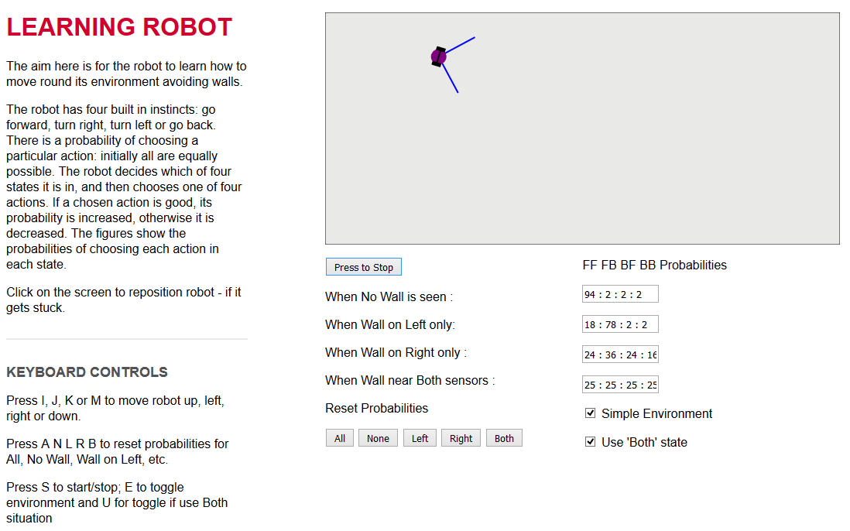
Learning in Mobile Robots
Robot can sense walls/ objects
Set speeds manually
Or Robot learn -trial & error
Demonstrated in video later …

Slide 19
Human Computer Interaction
Using a mouse is feedback : Ultimate HCI is ‘Virtual Reality’
Image
Computer
Move
-
+
-ment
Human
Also, Augmented Reality
Tele-operation - remote control.
Needs force feedback +touch – ‘haptics’

Slide 20
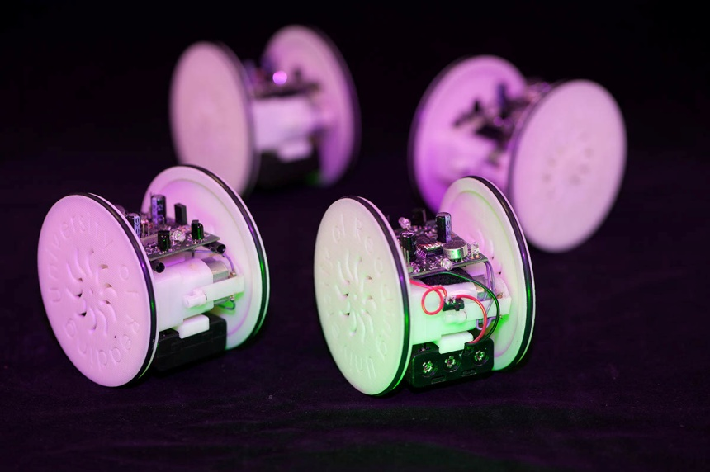
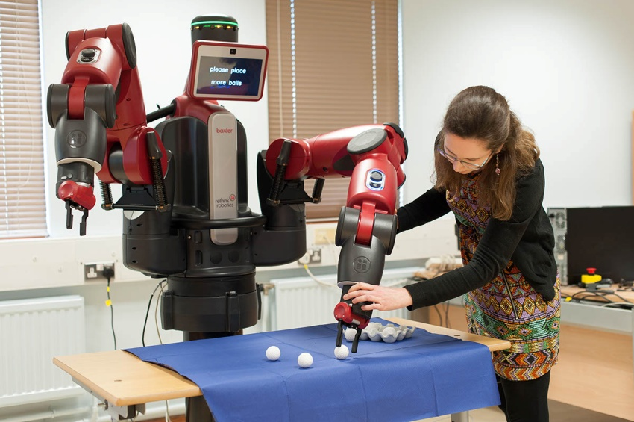
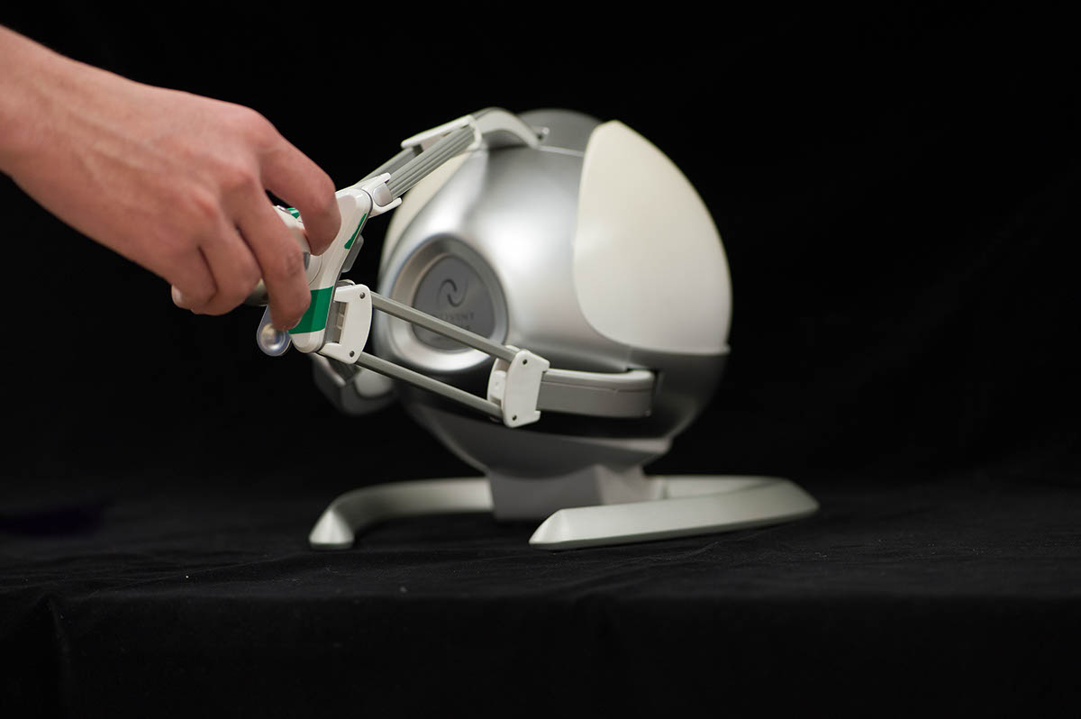
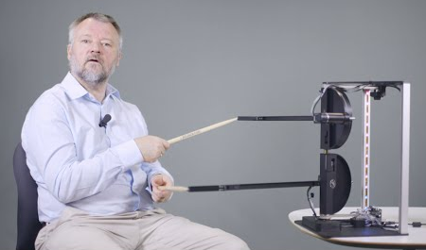
More Interaction
Robots with each other
Human and Computer
Haptics – feel artificial world
Virtual DrumKit

Slide 21
Robot and Light Sensors
About minute in …

Slide 22
Flocking Robots

Slide 23
Interaction and Learning
Baxter robot
Designed for safe interaction
Can program it to do tasks
Or can teach it
Eg move one arm by hand, other arm moves with it
So you teach it the moves so Baxter can pick up balls.

Slide 24
Some Web Pages

Slide 25
Balancing ERIC

Slide 26
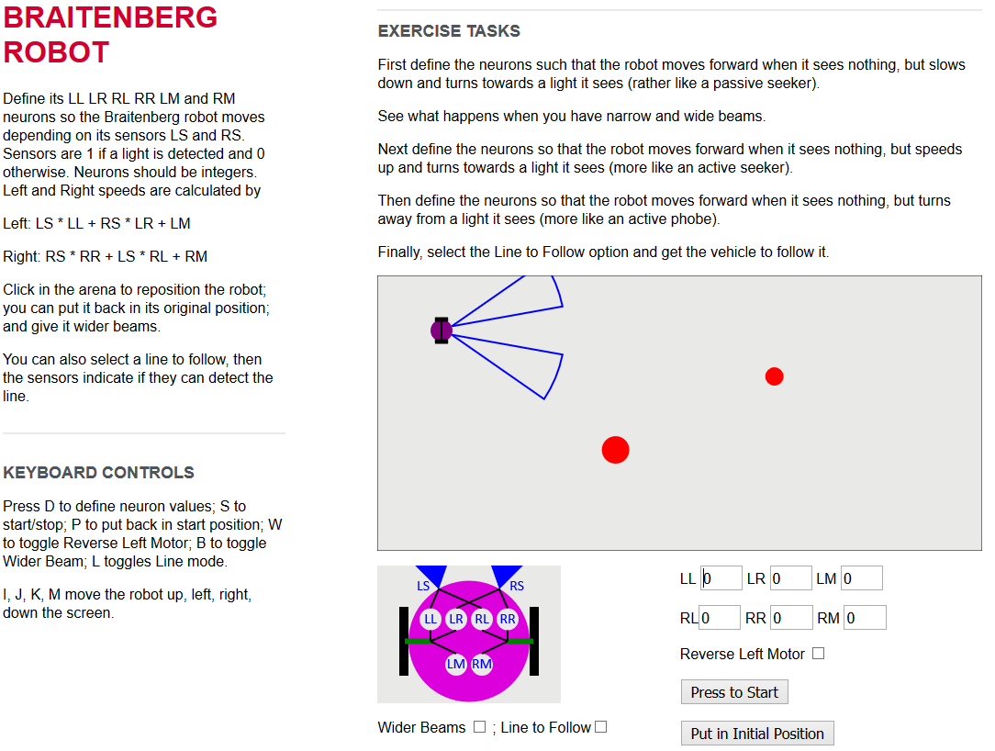
Braitenburg Robot

Slide 27
Very Positive Reaction
Teachers found simulations very useful and wanted to use at schools … hence pages available .. appreciated.
“Thank you for a truly excellent course that exceeded my expectations. By removing all the barriers to education that are still present in many online courses you allowed one to relax and concentrate on the learning. It made for a much more pleasant learning environment that encouraged exploration and experimentation. The use of simulations put this course head and shoulders above the competition.”

Slide 28
Summary
Begin Robotics introduces concepts
Cybernetics is key
Feedback for control, learning and interaction
Concepts used in different systems
Interactive pages helpful for explaining and learning
Around 50,000 enrolments so far
Students like I use it in UG class
Robotics good concepts, but not always good..

Slide 29
Robots Behaving Badly

Slide 30
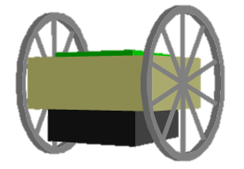
Balancing ERIC and Equiv Systems
When ERIC accelerates, it ‘rocks’
A = acceleration in, B board angle
Use change in B to reduce ‘rock’
A
B
Eric Body
Change in B
Just like damping in mass spring system
Notes:
Used in video so put at end

